Slide 1
Artificial Intelligence
Machine Learning
Deep Learning
Gen-AI
LLM
VLM

Slide 2
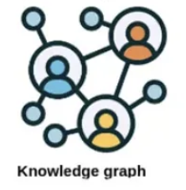


External Knowledge
Structured Knowledge Base
Retriever Module
Structured Query
RAG
Enhanced context
RAG
Enhanced context
Prompt
Prompt
User
User
Enhanced Response
Enhanced Response
Frozen
MLM
Frozen
MLM

Slide 3
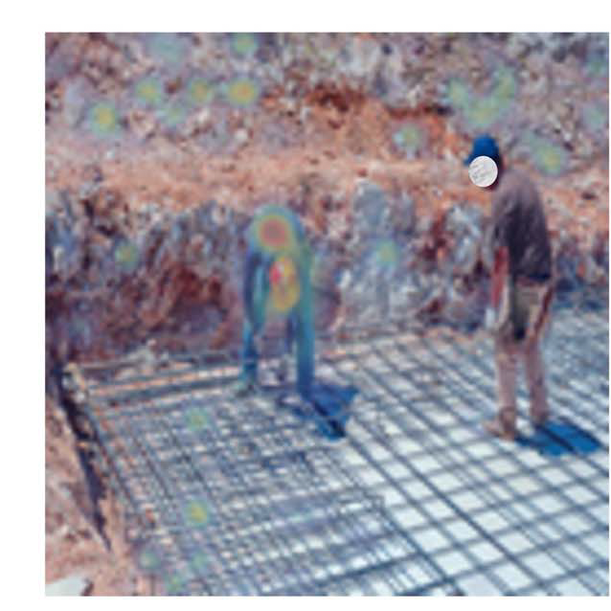
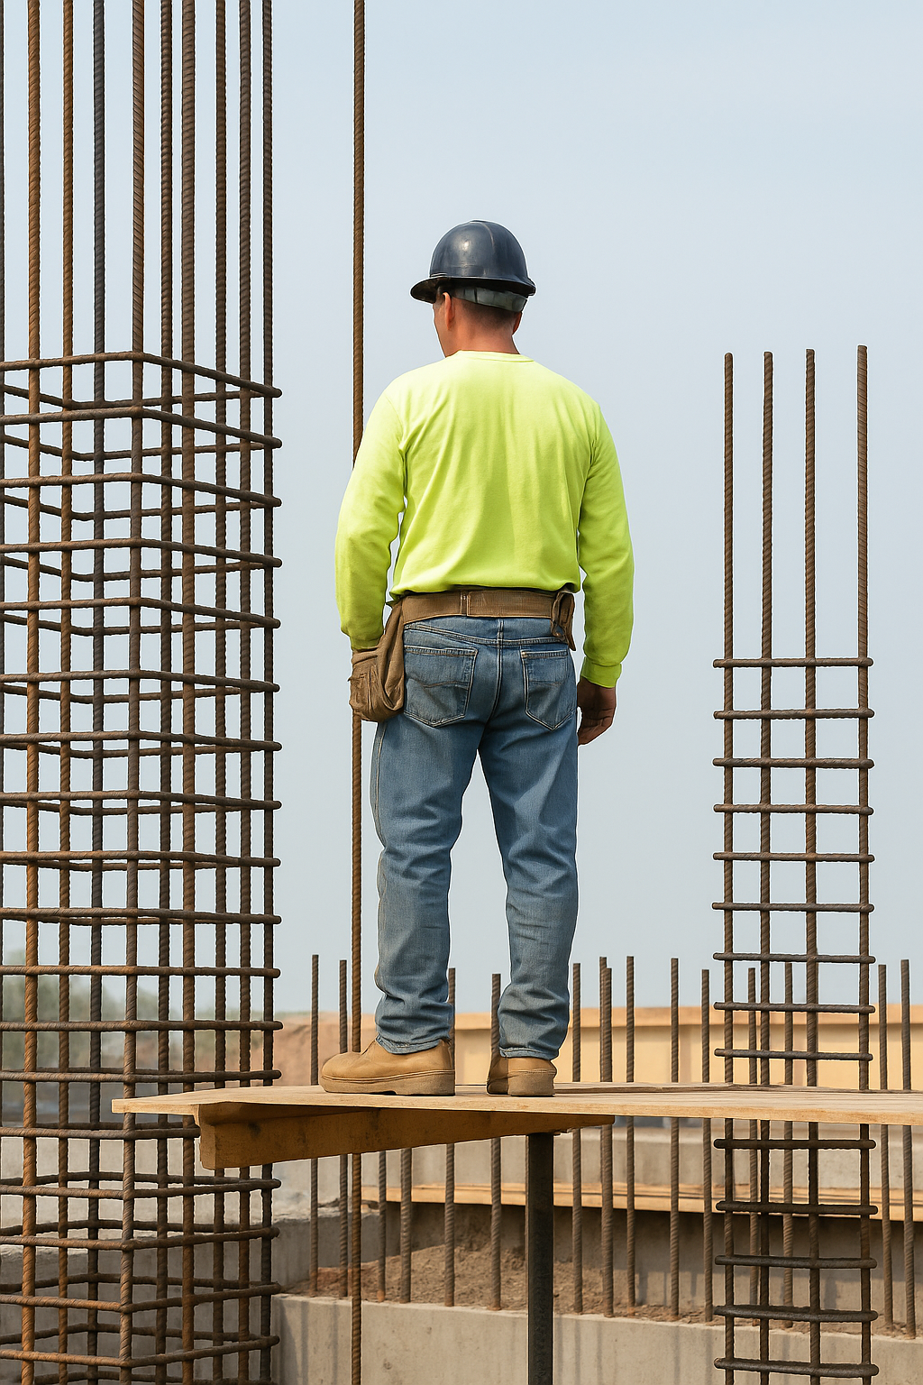
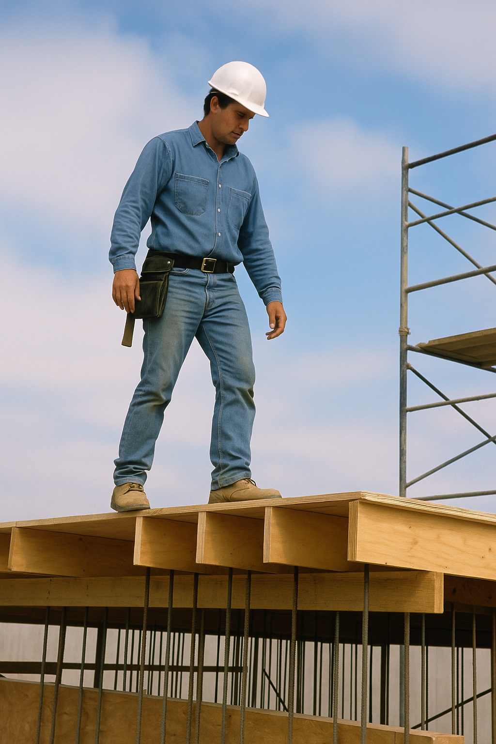
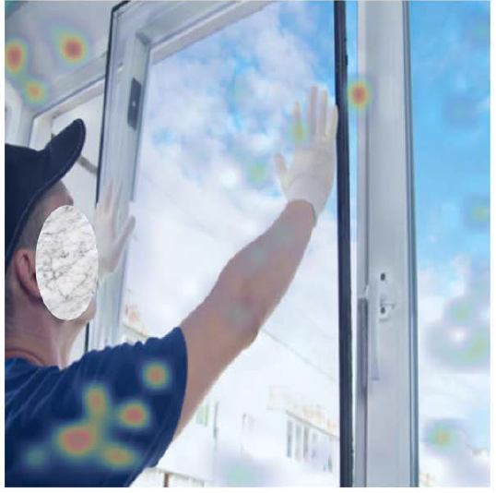
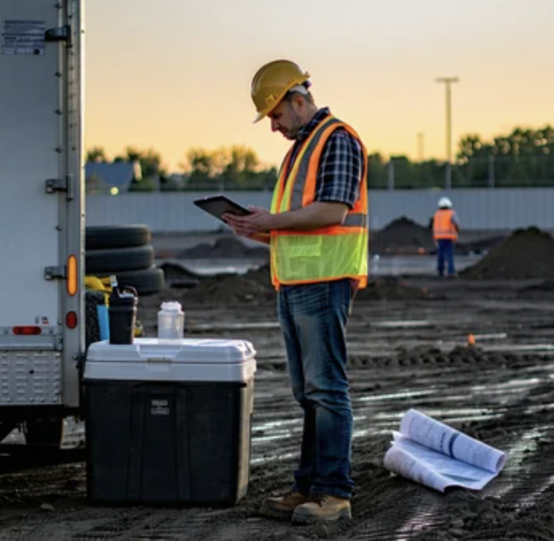


Risk
Tying rebars located lower level put workers lower back risk of injury
Solution
Use a rebar tying tool with extension handle
Risk
Holding window heavy put unnecessary stress shoulders
Solution
Use vacuum lifters
Violation
“Unbent or unprotected steel reinforcement”
Violation
“Fall protection damaged or not installed”
Original Image:
“A construction worker in job site.”
Body Shot:
“A man with iPad.”
Headshot:
“A man wearing helmet.”
Notes:
2,38,
44

Slide 4
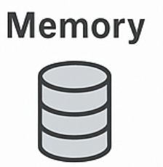

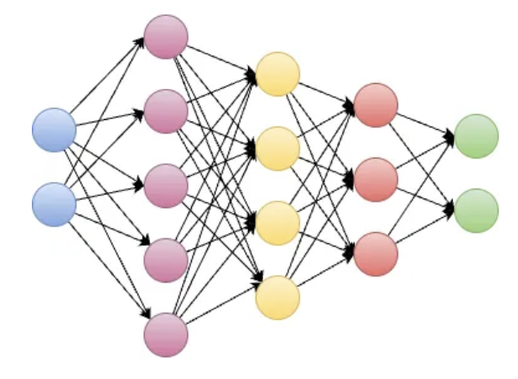
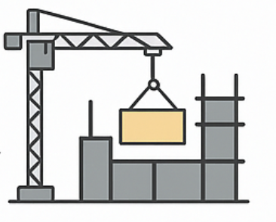
Input (Prompt)
Agent Reasoning
Prompt
Output
Prompt
Output
MLM
Observation
Action
Observation
Action
Output
Environment
Environment
(a)
(b)
(c)

Slide 5
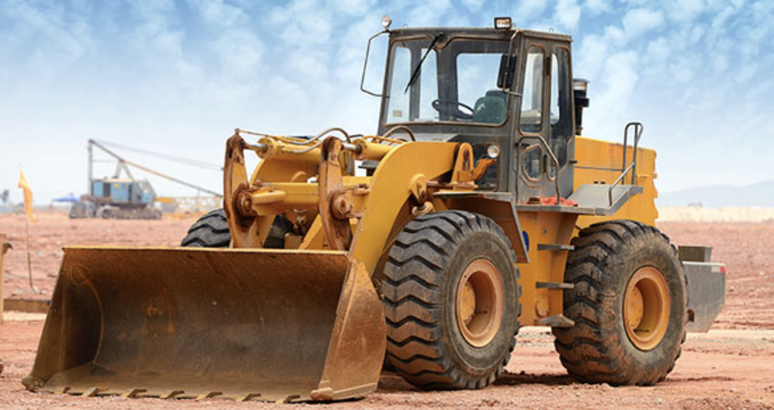
A photo of excavator
A photo of truck
…
Text Encoder
T1 | T2 | T3 | … | TN
A photo of loader
I
I*T1 | I*T2 | I*T3 | … | I*TN
Input Label
Image Encoder
A photo of loader
Predicted Label
Input Image

Slide 6
Prompting
Fine Tuning
User
User
Dynamic Description & Examples
Fixed Description & Examples
Frozen Weights
Trainable Weights
Loss Function
Response
Response

Slide 7
Output Probability
Add & norm
Feed Forward
Output Probability
Add & norm
Add & norm
Masked
Multi-Head Attention
Add & norm
Feed Forward
Feed Forward
Add & norm
Add & norm
Add & norm
Masked
Multi-Head Attention
Masked
Multi-Head Attention
Masked
Multi-Head Attention
Positional Encoding
Positional Encoding
Positional Encoding
Input Embedding
Output Embedding
Output Embedding
Input
Output
Output

Slide 8




Architecture Innovations
Scaling and Generalization
Multimodal Intelligence
Foundational LLMs
Foundation Models
MLLMs
2018:
BERT – Encoder only & Text only
GPT-1 – Decoder only & Text only
2019:
GPT-2 – Decoder only & Text only
T5 – Encoder-Decoder & Text only
2020:
GPT-3 – Decoder only & Text only
2021:
CLIP – Dual Encoder & Text + vision
DALL.E – Decoder only & Vision to text
2022:
PaLM – Decoder only & Text only
GPT-3.5: Decoder only & Text only
ChatGPT: Decoder only & Text only
2023:
GPT-4 – Decoder only & Text + Vision
MiniGPT-4 – Decoder only & Text + Vision
LLaVA – Decoder only & Text + Vision
2024:
Gemini 1 – Encoder–Decoder & Multimodal
GPT-4o – Decoder only & Multimodal

Slide 9
Scopus
TITLE-ABS-KEY ( "large language model" OR "LLM" OR "LLM-based" OR "GPT" OR "ChatGPT" OR "vision language model" OR "VLM" OR "multimodal AI" OR "multimodal language model" OR "Generative AI" OR "Generative models" ) AND TITLE-ABS-KEY ( "construction" OR "construction management" OR "construction industry" OR "construction automation" ) AND PUBYEAR > 2021 AND PUBYEAR < 2026 AND ( LIMIT-TO ( SUBJAREA , "ENGI" ) ) AND ( LIMIT-TO ( LANGUAGE , "English" ) ) AND ( LIMIT-TO ( DOCTYPE , "ar" ) OR LIMIT-TO ( DOCTYPE , "cp" ) ) AND ( LIMIT-TO ( SRCTYPE , "j" ) OR LIMIT-TO ( SRCTYPE , "p" ) )

Slide 10
Scopus – resulted in 418 initial list
In Scopus – search time was 2020-2025 (Feb)
Query search
Subject area: Engineering
English
Article and Conference Proceedings

Slide 11
Web of Science
https://www.webofscience.com/wos/woscc/summary/41803267-dc6d-4895-a974-1ae5d9be89b8-0170c16611/relevance/1
TS=(“large language model” OR “LLM” OR “LLM-based” OR “GPT” OR “ChatGPT” OR “vision language model” OR “VLM” OR “multimodal AI” OR “multimodal language model” OR “Generative AI” OR “Generative models”)
AND
TS=(“construction” OR “construction management” OR “construction industry” OR “construction automation”)

Slide 12
Web of Science
In Scopus – search time was 2020-2025 (Feb)
Query search
Research area: Engineering, Construction Building Technology
English
Article and Conference Proceedings

